Slide 1
Carbon Dating The Web: Estimating the Age of Web Resources
Written by: Hany M. SalahEldeen and Michael L. Nelson
[1304.5213] Carbon Dating The Web: Estimating the Age of Web Resources
Presented by Noah Jennings

Slide 2
Introduction
Ever wonder when a web resource first appeared?

Slide 3
Ideal
Reality
Resources are accompanied by a timestamp
Date, time, timezone
Few resources come with an adequate timestamp
Various formats

Slide 4
Issues
Archives do not hold ALL pages
Delay between creation and archiving
AND between archiving and release
Creation time is unknown

Slide 5
Solution
Compile multiple sources
Used found data to estimate web resources creation date

Slide 6
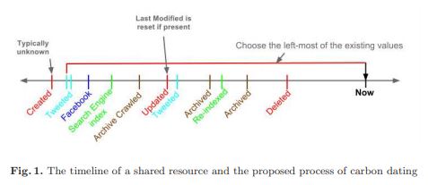
Overview
Analyze:
Resource & server
Search Engine Backlinks
Social Media Backlinks
Archives
Search Engine Indexing
Hany M. SalahEldeen, Michael L. Nelson, Carbon Dating The Web: Estimating the Age of Web Resources, Proceedings of the Temporal Web Workshop, 2013 (also available as: Technical Report arXiv:1304.5213).

Slide 7
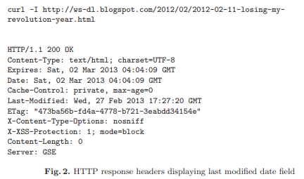
Phase 1: The Resource & Server
Send a request for headers
Collect returned timestamp
Understood to have errors
Request
Timestamp
Hany M. SalahEldeen, Michael L. Nelson, Carbon Dating The Web: Estimating the Age of Web Resources, Proceedings of the Temporal Web Workshop, 2013 (also available as: Technical Report arXiv:1304.5213).

Slide 8
Phase 2a: Backlinks in Search Engines
Backlinks
A link created on page A referring to the desired page B
page A is the backlink
CAN BE SHORTENED
Google API to get an unfinished list of backlinks to a specific web resource
Used Memento to explore the multiple versions of the backlinks
Extracted/stored each timestamp
Utilized binary search to find the earliest backlink creation
Used to represent the resources backlink creation date

Slide 9
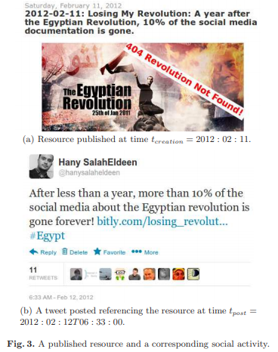
Phase 2b: Backlinks in Social Media
Twitter/Facebook create backlinks
Combine date on page and time of post
Date
Time
Hany M. SalahEldeen, Michael L. Nelson, Carbon Dating The Web: Estimating the Age of Web Resources, Proceedings of the Temporal Web Workshop, 2013 (also available as: Technical Report arXiv:1304.5213).

Slide 10
Topsy
Bitly
Allows for further digging of tweets (500 tweets)
Collected post times are extracted
Datetime of earliest found tweet is stored
Utilizes URI shortening
Stores datetime and number of times visited
Earliest is stored

Slide 11
Phase 3: Archives
Most straightforward approach
Utilizes Momento framework
Stores earliest timestamp

Slide 12
Phase 4: Search Engine Indexes
Short time between creation and discovery
Extract the last date a resource was crawled
Store this date

Slide 13
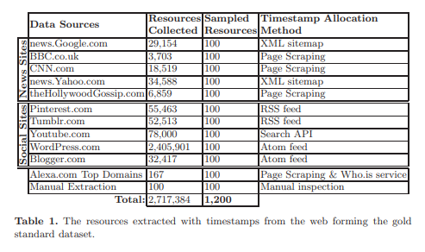
Ground Truth
Reduce Bias
Variety of sources
Ensure usability
Quality timestamps
GT Web Resources
Hany M. SalahEldeen, Michael L. Nelson, Carbon Dating The Web: Estimating the Age of Web Resources, Proceedings of the Temporal Web Workshop, 2013 (also available as: Technical Report arXiv:1304.5213).

Slide 14

Analysis
Convert estimated/real timestamps to UTC (coordinated universal time)
Δt_{method}
Calculate the difference between real and estimate
Δt_{least}
Calculate the difference between real and the most accurate method
Hany M. SalahEldeen, Michael L. Nelson, Carbon Dating The Web: Estimating the Age of Web Resources, Proceedings of the Temporal Web Workshop, 2013 (also available as: Technical Report arXiv:1304.5213).

Slide 15
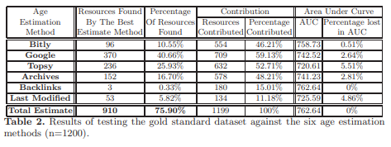
Results
Findings
Hany M. SalahEldeen, Michael L. Nelson, Carbon Dating The Web: Estimating the Age of Web Resources, Proceedings of the Temporal Web Workshop, 2013 (also available as: Technical Report arXiv:1304.5213).

Slide 16
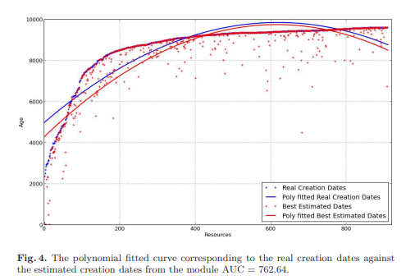
GT vs. Estimations
Hany M. SalahEldeen, Michael L. Nelson, Carbon Dating The Web: Estimating the Age of Web Resources, Proceedings of the Temporal Web Workshop, 2013 (also available as: Technical Report arXiv:1304.5213).

Slide 17
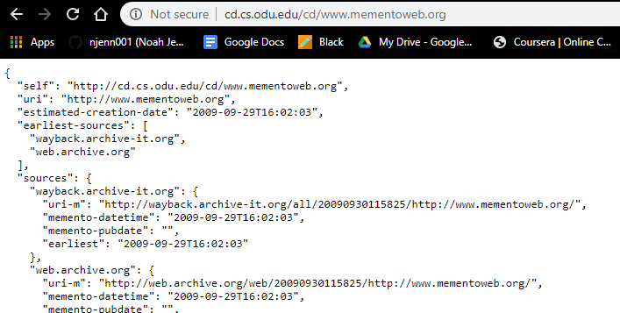
Carbon Date API
Public web service to estimate age of web resource
Returns a JSON file depicting the desired web page, creation time estimations, sources, etc.
Desired Web resource

Slide 18
Conclusion
The creation time for 75.90% of tested web pages was estimated accurately
The public can estimate the creation time of any web resource
http://cd.cs.odu.edu/cd/

Slide 19
References
Hany M. SalahEldeen, Michael L. Nelson, Carbon Dating The Web: Estimating the Age of Web Resources, Proceedings of the Temporal Web Workshop, 2013 (also available as: Technical Report arXiv:1304.5213).

